Slide 1





SHIELD INSURANCE PERFORMANCE ANALYSIS REPORT
CREATED BY - Dr. AJAY SINGH CHAUHAN
Medical Graduate , Medical Data Analyst
DrAjaysingh chauhan | LinkedIn
ajayconnect (DrAjaysingh chauhan) (github.com)

Slide 2
Project Overview : My role as a Medical Data Analyst Intern involved engaging with our client, Shield Insurance, to understand their needs, analyze data, and create a user-friendly smart dashboard. The goal was to empower Shield Insurance with valuable business insights for informed decision making
About Company :
Shield Insurance is renowned for offering comprehensive coverage, protecting individuals from life's uncertainties. Their commitment to reliable coverage sets them apart in the industry
Shield Insurance provides a diverse range of 9 policies, catering to the needs of customers through both online platforms such as the website and app, as well as offline channels
facilitated by agents and direct services. The sales operations are strategically spread across major cities including Delhi, NCR, Indore, Chennai, Mumbai, and Hyderabad.
POLICES AND SALES :
This extensive array of policies ensures that customers have a variety of options to choose from based on their individual requirements.
The convenience of online transactions via the website and app offers a modern and efficient way for clients to explore and purchase policies from the comfort of their homes

Slide 3
Policies Overview
BASIC OBSERVATIONS
Total Revenue : 989.25 millions INR
Total Customer Base : 26,841
Customer’s Age Groups : 18- 65+
Policy ID Premium POL4321HEL 5000 POL4331HEL 7500 POL3309HEL 12000 POL5319HEL 16700 POL6303HEL 21500 POL6093HEL 31700 POL9221HEL 42500 POL1048HEL 76500 POL2005HEL 120000
The company has 2 sales modes with 2 categories
within each mode.
Offline Mode
Sales Agent
Direct Sale
Online Mode
Application
Websites

Slide 4
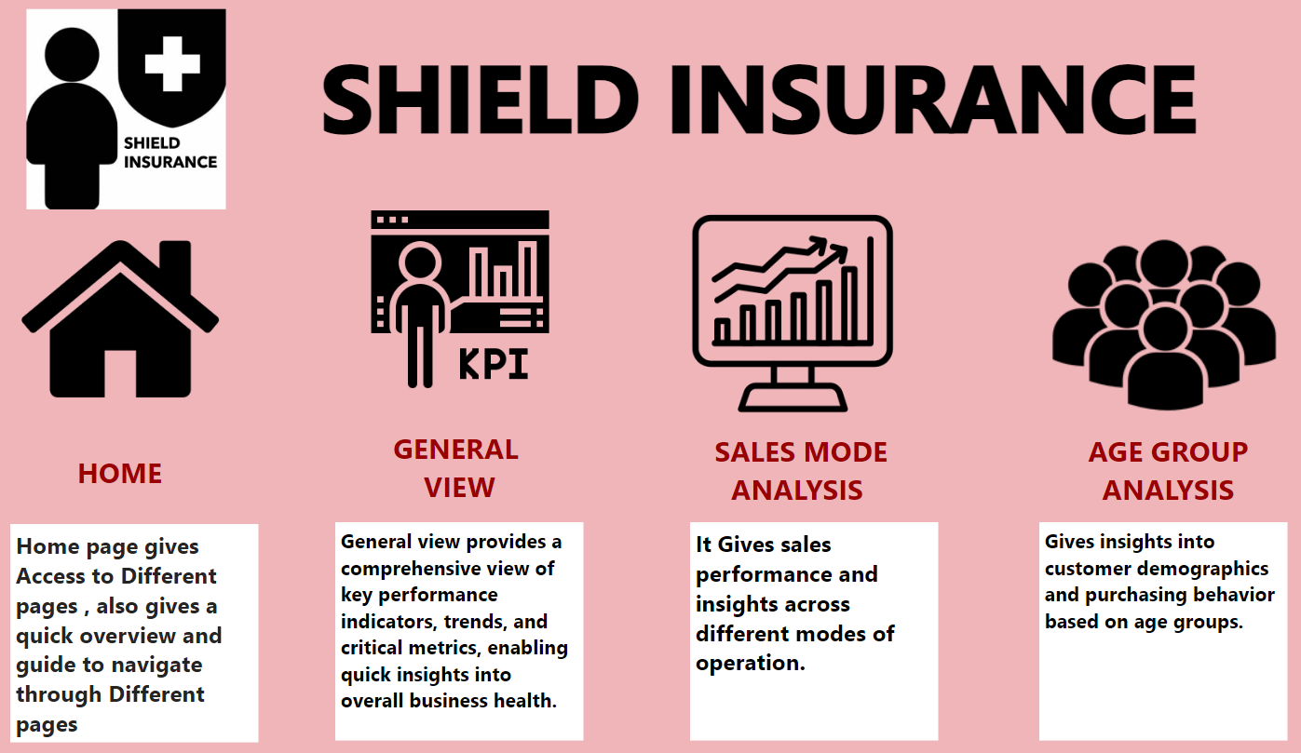
Dash Board Overview : The dashboard is organized into four distinct pages, each serving a specific purpose to enhance user experience and provide comprehensive insights. Let's delve into the details of each section:

Slide 5
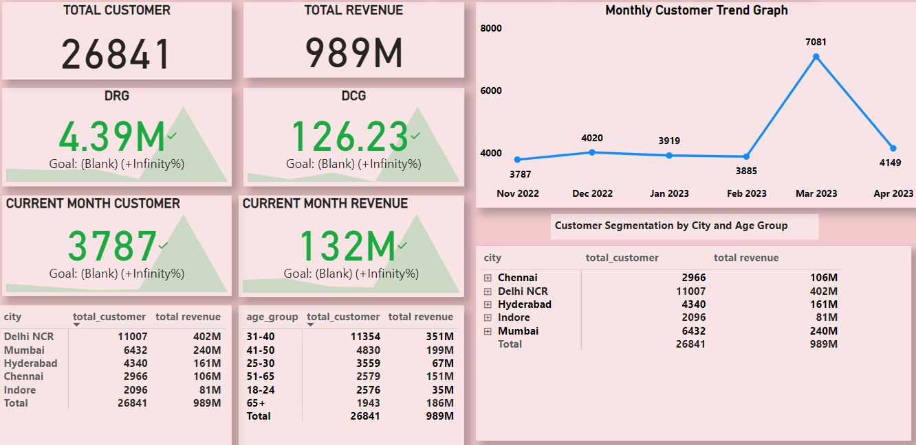
GENERAL VIEW
INSIGHTS
Delhi NCR leads in Revenue and Customer
Acquisition Among all the cities, with a total
of 11,007 Customers and 402 M Revenue
The Highest Revenue-Generating month is March with 264 Millions
The Highest Customer Acquisition month
is March with 7081 Customers
The Age Group with the highest revenue
& Highest number of customers is 31-40
years

Slide 6
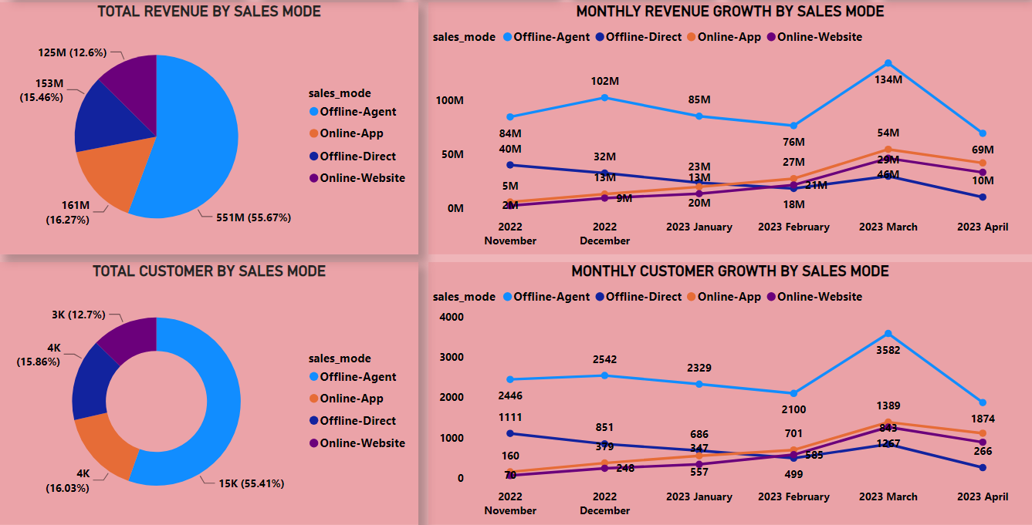
SALES VIEW Insights
The Most Successful Sales Mode for
Revenue and Customer Acquisition is the
Offline-Agent Mode
The Offline Agent Channel Acquires the
Majority of Clients Accounting for 55.41 % Customers & 55.67% of Revenue
Online App and Online Website showed revenue growth from
Feb 2023, while Offline-Direct declined
Offline-Agent mode showed a sudden Decline in the month of March ,
Offline Direct mode is the worst performing mode, certain changes need to be Done to boost performance

Slide 7
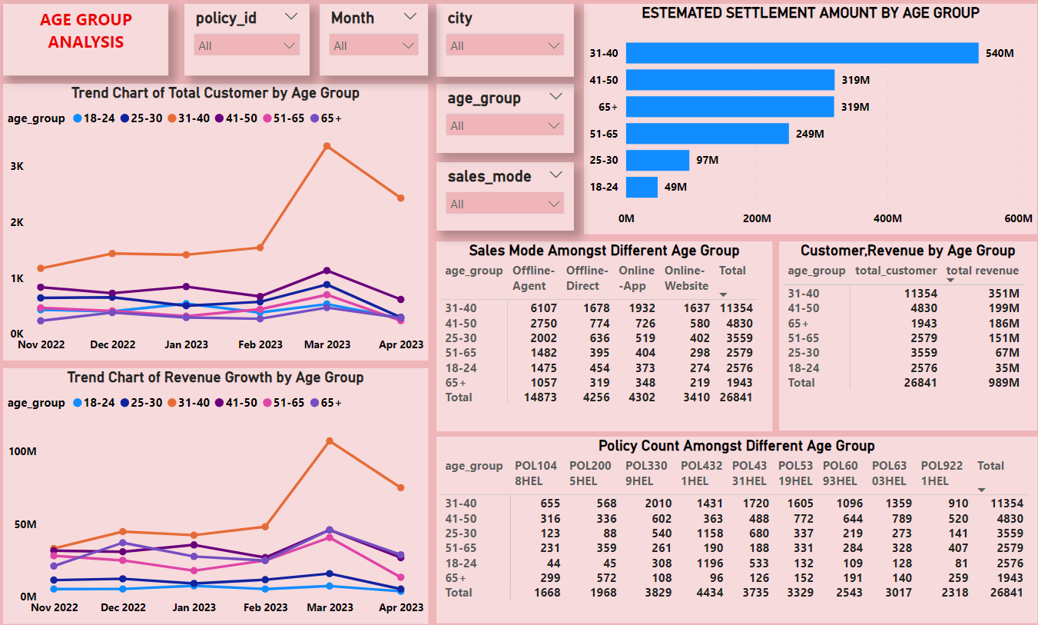
The 31-40 age Group Appeared as the most prominent Customer Base Across all Policies while 65+ has the lowest one
AGE GROUP
VIEW INSIGHTS
The 31-40 age Group has the Highest Contributed in term of Revenue collection while 18-24 age group has lowest one
The 31-40 age Group has the Highest 540M Estimated settlement Amount while 18-24 Age Group has the Lowest 49M.
Policy 'POL4321HEL' with a base premium of ₹5,000/-
gathered a customer base exceeding 4000 as highest amongst all the policies

Slide 8
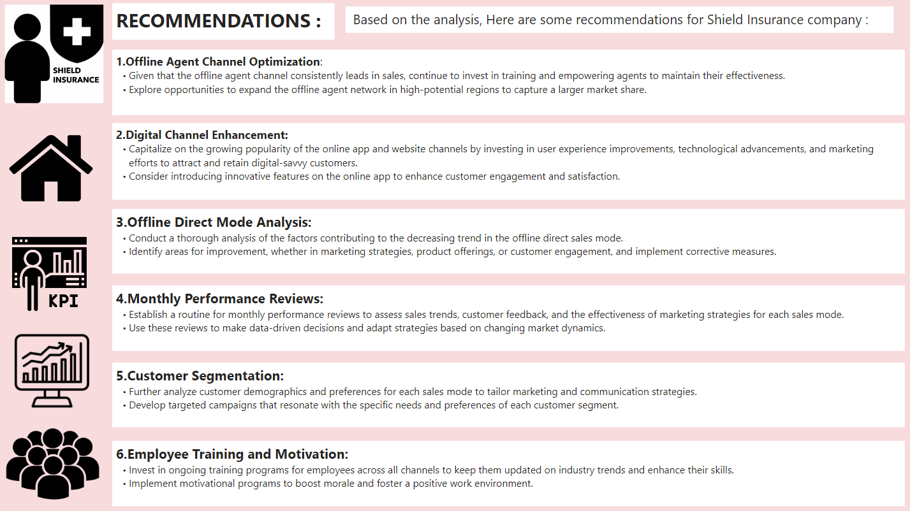

Slide 9
Acknowledgments
“ Before I conclude, I would like to express my gratitude to
Dhaval Patel Sir and Hemanand Vadivel Sir
for their guidance
and support throughout this internship “
THANK YOU FOR
WATCHING

